Slide 1
Big Data Architecture and Governance
Group Project | San Francisco Building Permits
Group 7
Parthiv Shah
Venkata Lakshmi Mahitha Mandalapu
Venkateshkumar Sivakumar

Slide 2
1. INTRODUCTION

Slide 3

Data - Know Me!
San Francisco Building Permits : A Building Permit is an official approval document issued by a governmental agency that allows you or your contractor to proceed with a construction or remodeling project on one's property
For the city of San Francisco, permit issuing is taken care by www.sfdbi.org/
Property | Info
Data collected from | Jan 1st, 2013 to Feb 25th, 2018
Source | https://www.kaggle.com/
Columns | 43
Rows | 200k
Data Format | CSV file

Slide 4
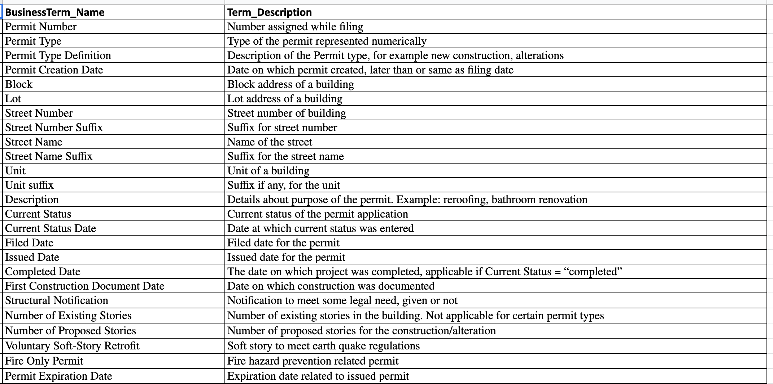
Business Terms (Data Dictionary)

Slide 5
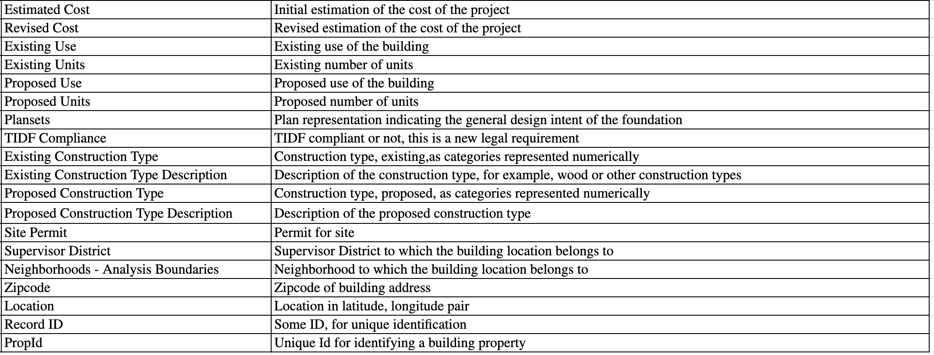
Business Terms (Data Dictionary)

Slide 6
Impact Statement
In the recent past, several posts and blogs highlighted that main discrepancy in demand and supply in real estate industry is due to delays in issuing building permits.
The purpose of this project is to understand and improve the transparency in the data, store the data in database and visualize the data in a way useful for people of all classes (General Public, Contractors, Media, and Government).

Slide 7
Project Objectives/Goals:
Gather the data from sources
Perform profiling and clean the data
Design the data model to store the data
Transform and Integrate the data to database
Perform data validation
Use the data from database and create visualizations

Slide 8
2. VISION DIAGRAM

Slide 9




















Data Sources
Destination
Data Profiling and Cleaning
Builders
Media
San Francisco Building Permits
Data Capture
Data Modelling
Data Visualization
Government Agency
Data Integration and Storage
Buildings Data

Slide 10
3. DATA PROFILING AND CLEANING

Slide 11
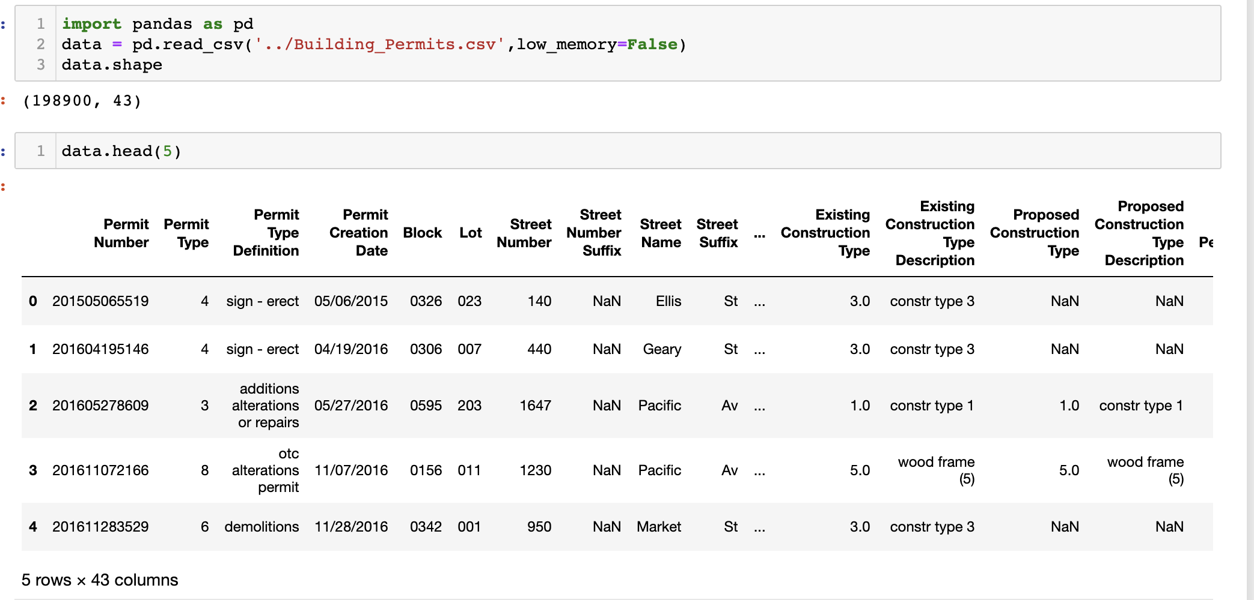
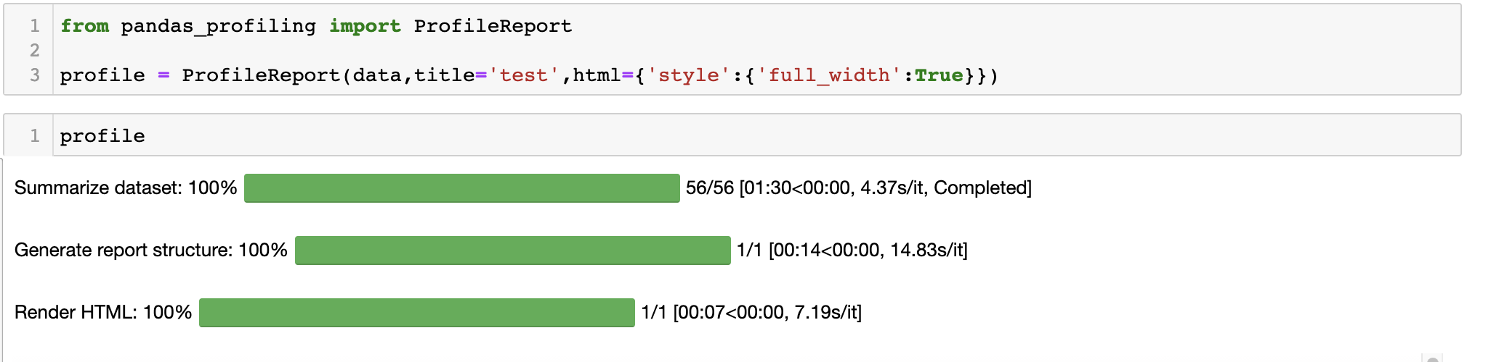
Data Gathering and Profiling
Data is gathered from input csv file to python pandas dataframe
Detailed profiling on data is done using pandas-profiling

Slide 12
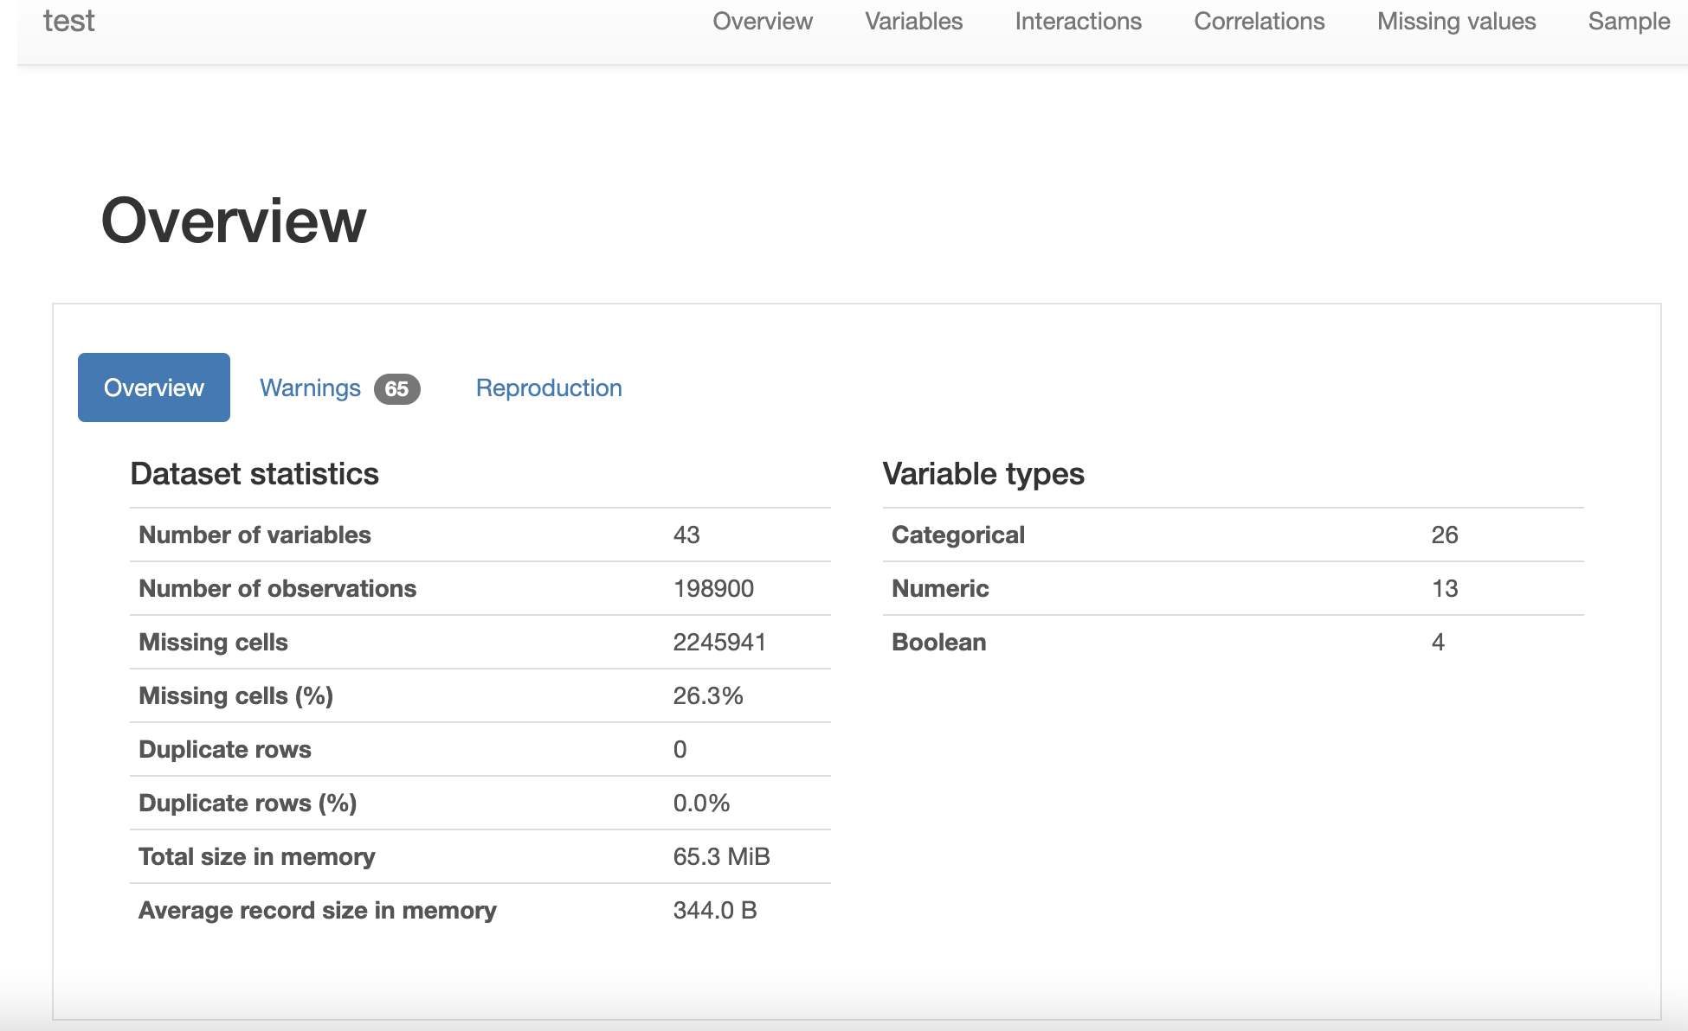
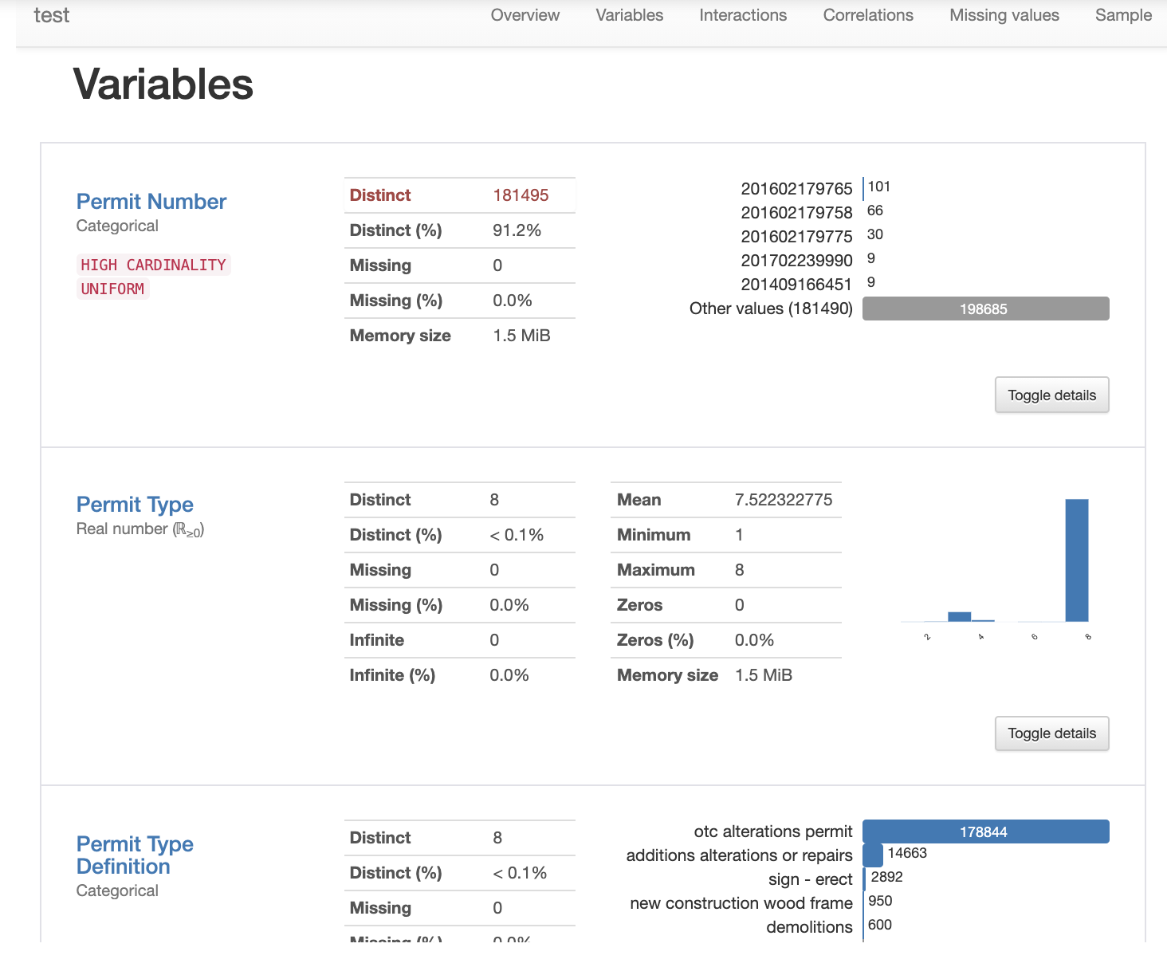
Data Profiling
Overview of profiling:
Column-wise Analysis:

Slide 13
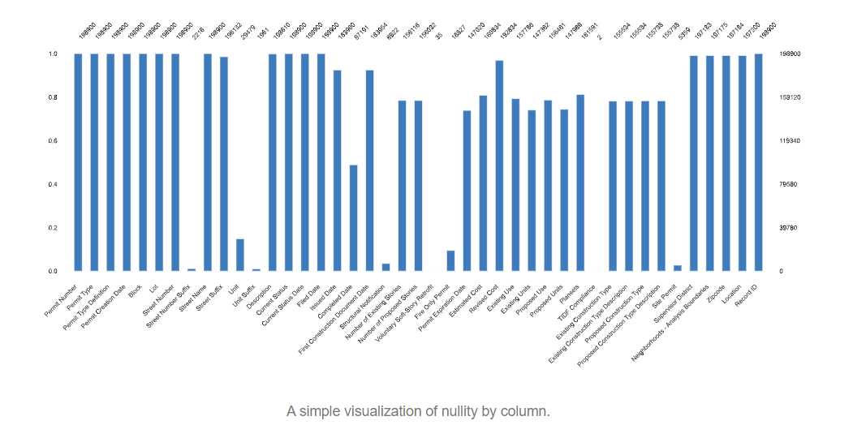
Data Profiling
Non-null values by column:

Slide 14
Data Profiling
Observations:
No duplicate rows in the data
Column-wise analysis
Number of duplicates
Missing data
Aggregations
Decisions:
Identified unique Id column from the existing columns
Decided on what to replace for missing values (”Not_Available”)
Rename column names removing spaces between the words

Slide 15
4. Data Modelling/Design

Slide 16
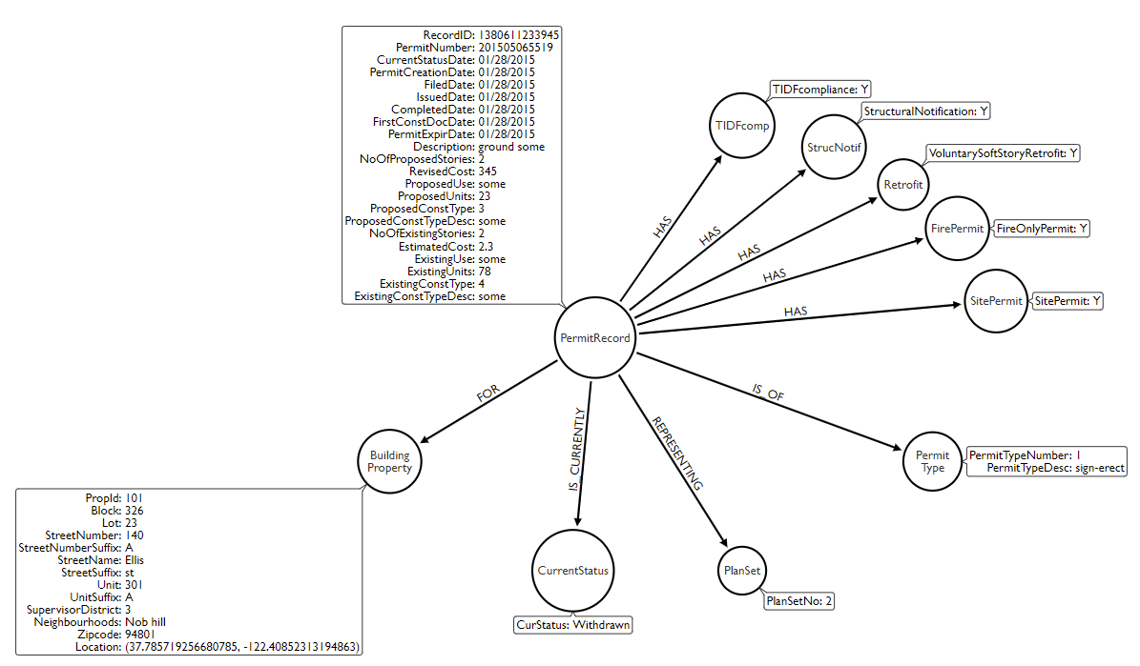
Design Model
Unique Property is identified for each node
For BuildingProperty node, a new column (PropId) is added to the data to have a unique constraint

Slide 17
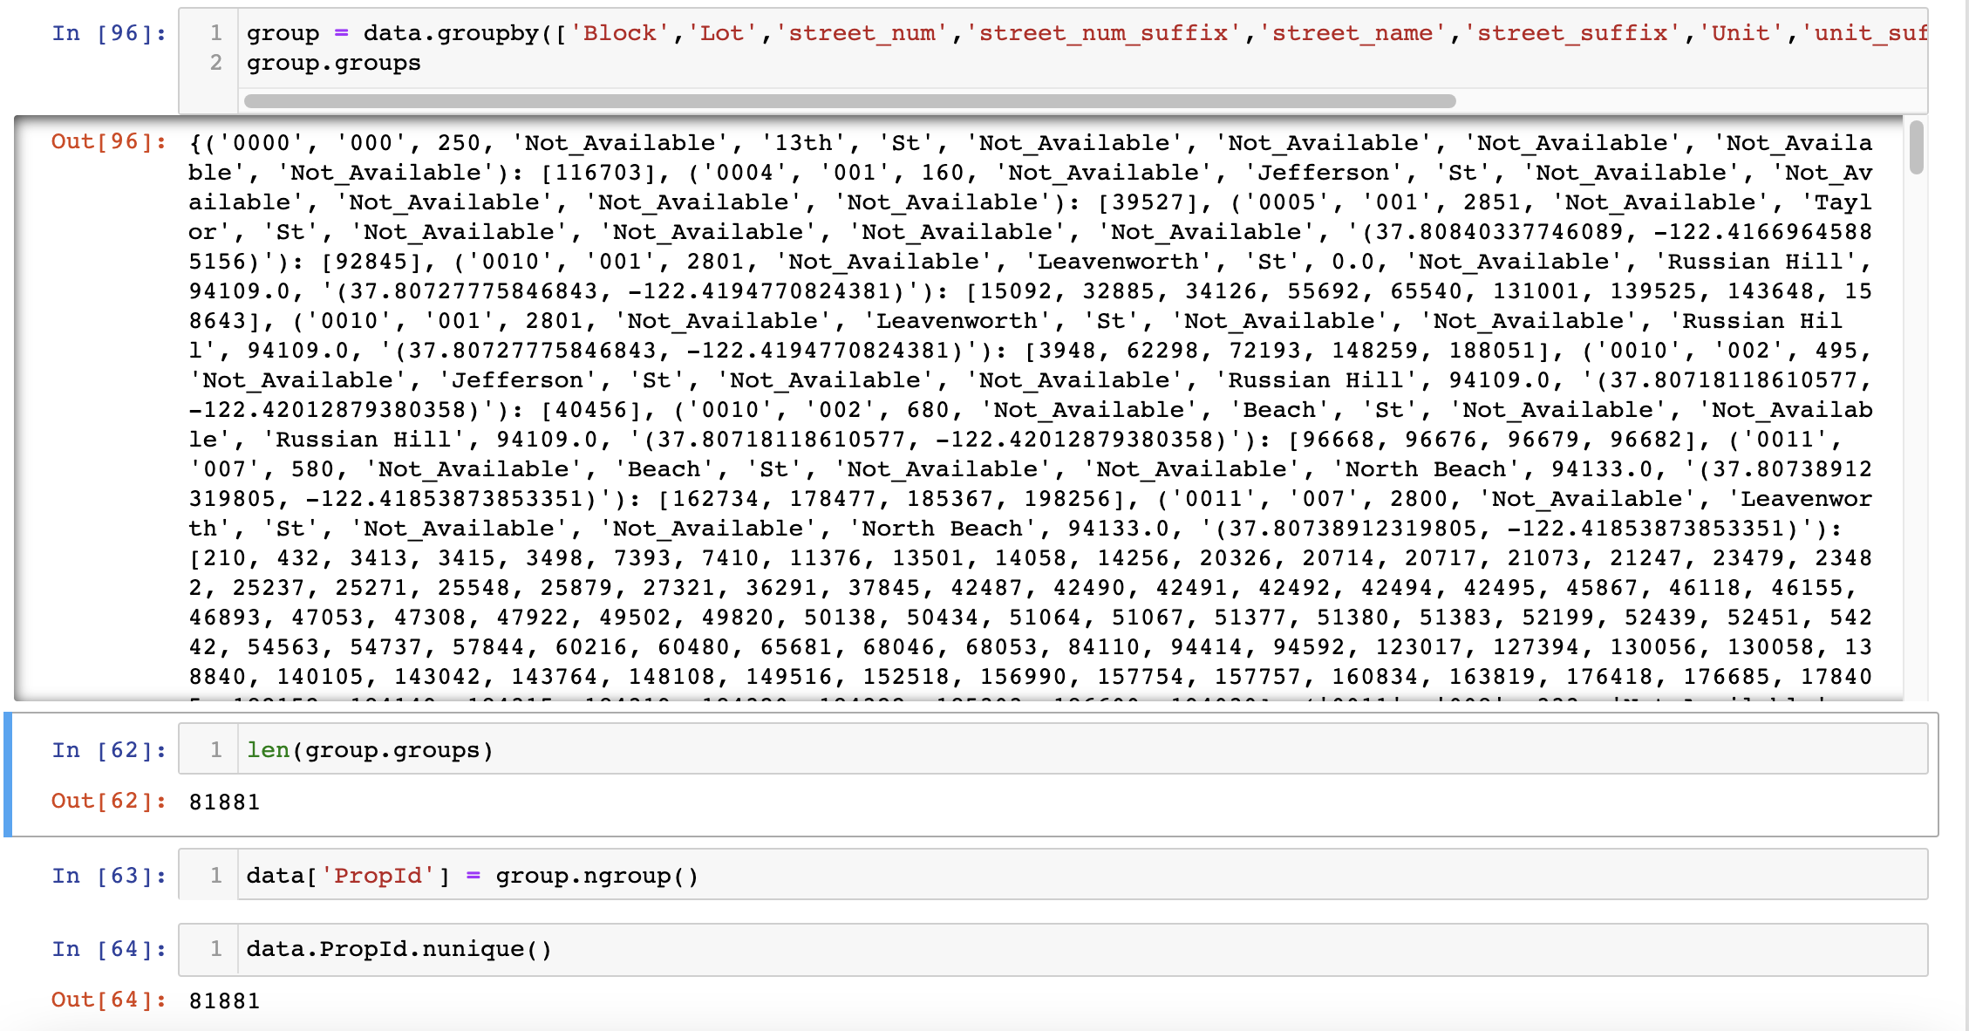
Design
For BuildingProperty node, a new column (PropId) is added to the data to have an index
The new column is created by grouping all the building property related columns:

Slide 18
5. DATA MAPPING AND INTEGRATION

Slide 19

Data Loading
The cleaned data is now sent to database (Neo4J) using cypher according to data model
The cypher is created for the whole data in following steps:
Step1 : Create constraints for all nodes (Indexes)
Step2 : Create nodes
Step3 : Create relationships between nodes
A sample cypher for two of the nodes:

Slide 20
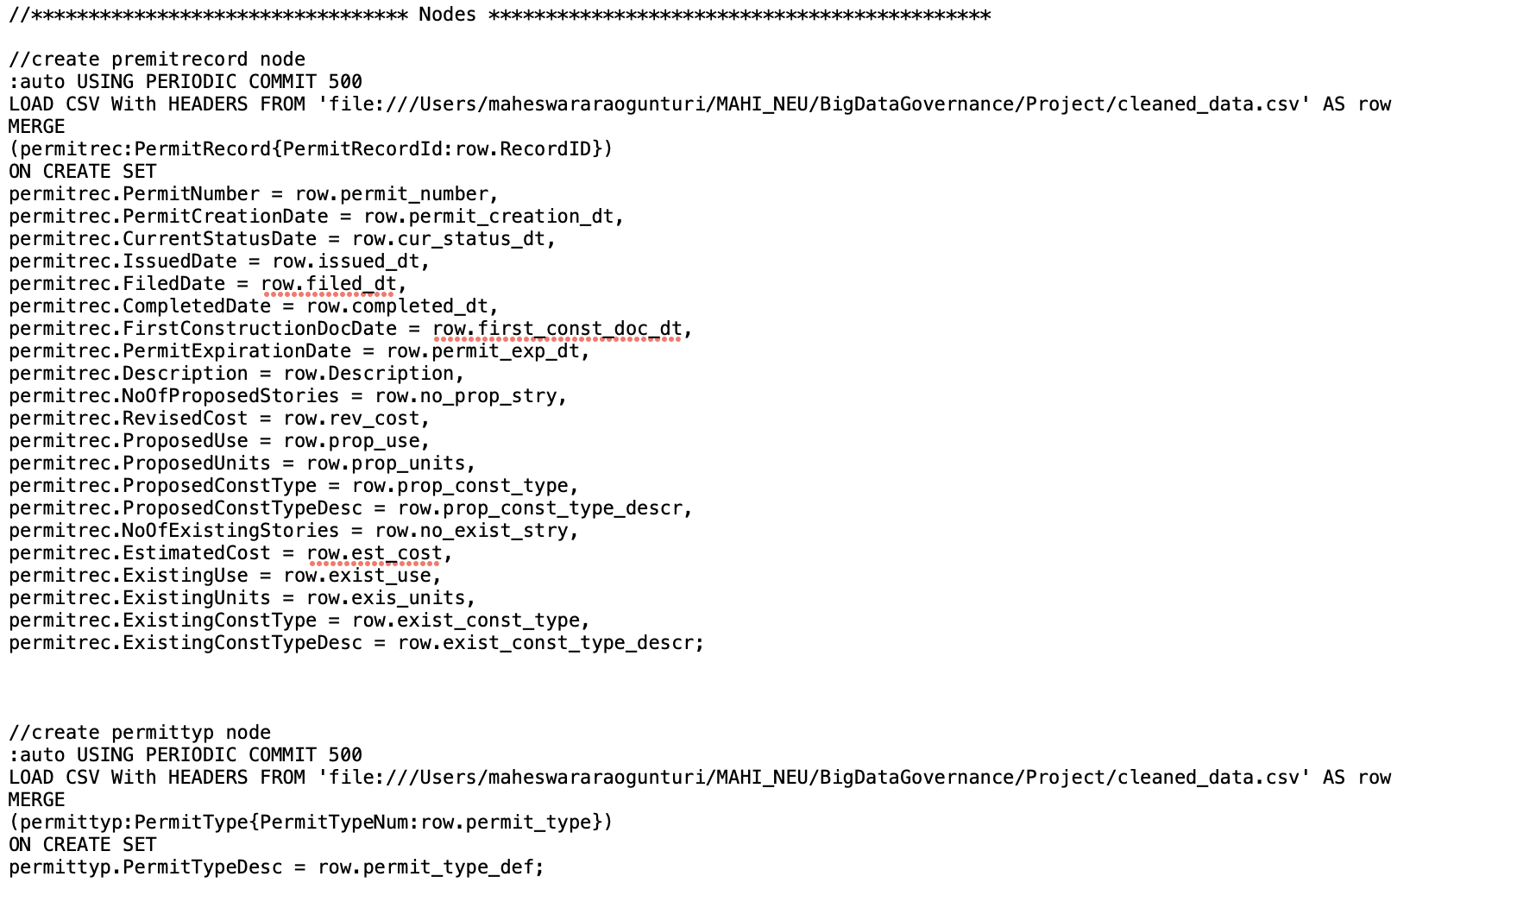
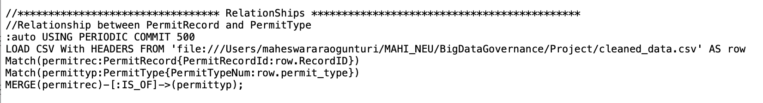
Data Loading
Creating indexes made the loading very fast
The parameter names and node names should be in sync in each step

Slide 21
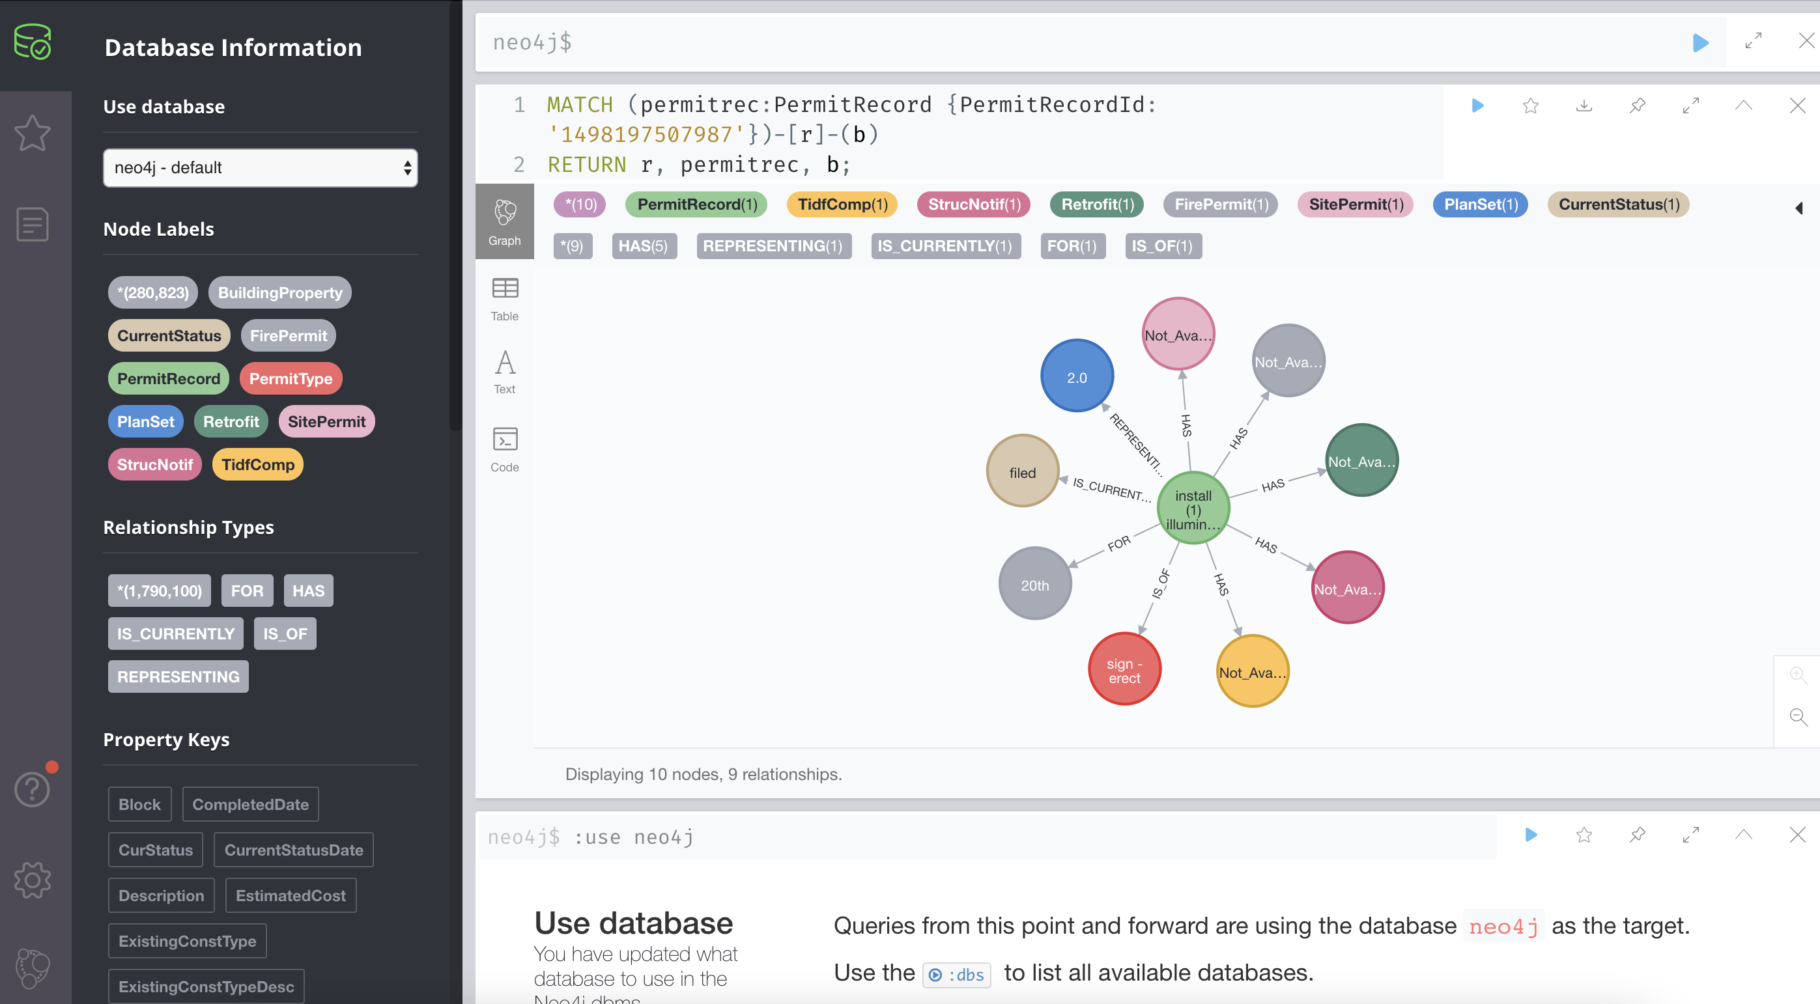
Data Loading

Slide 22
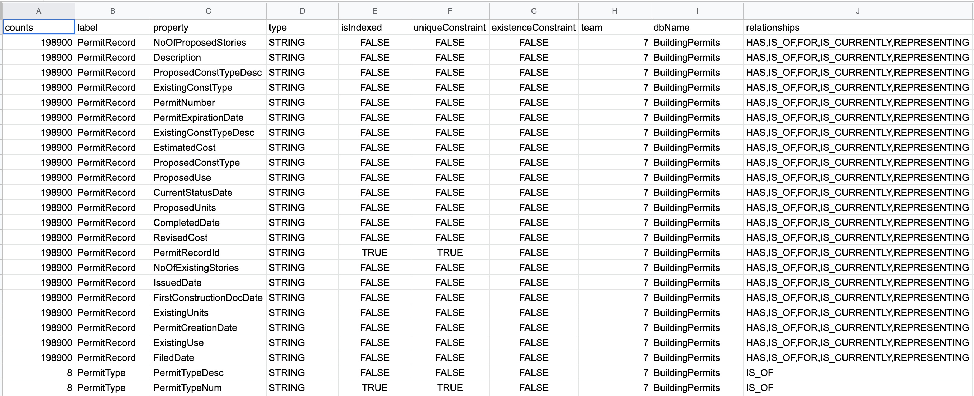
Technical Metadata

Slide 23
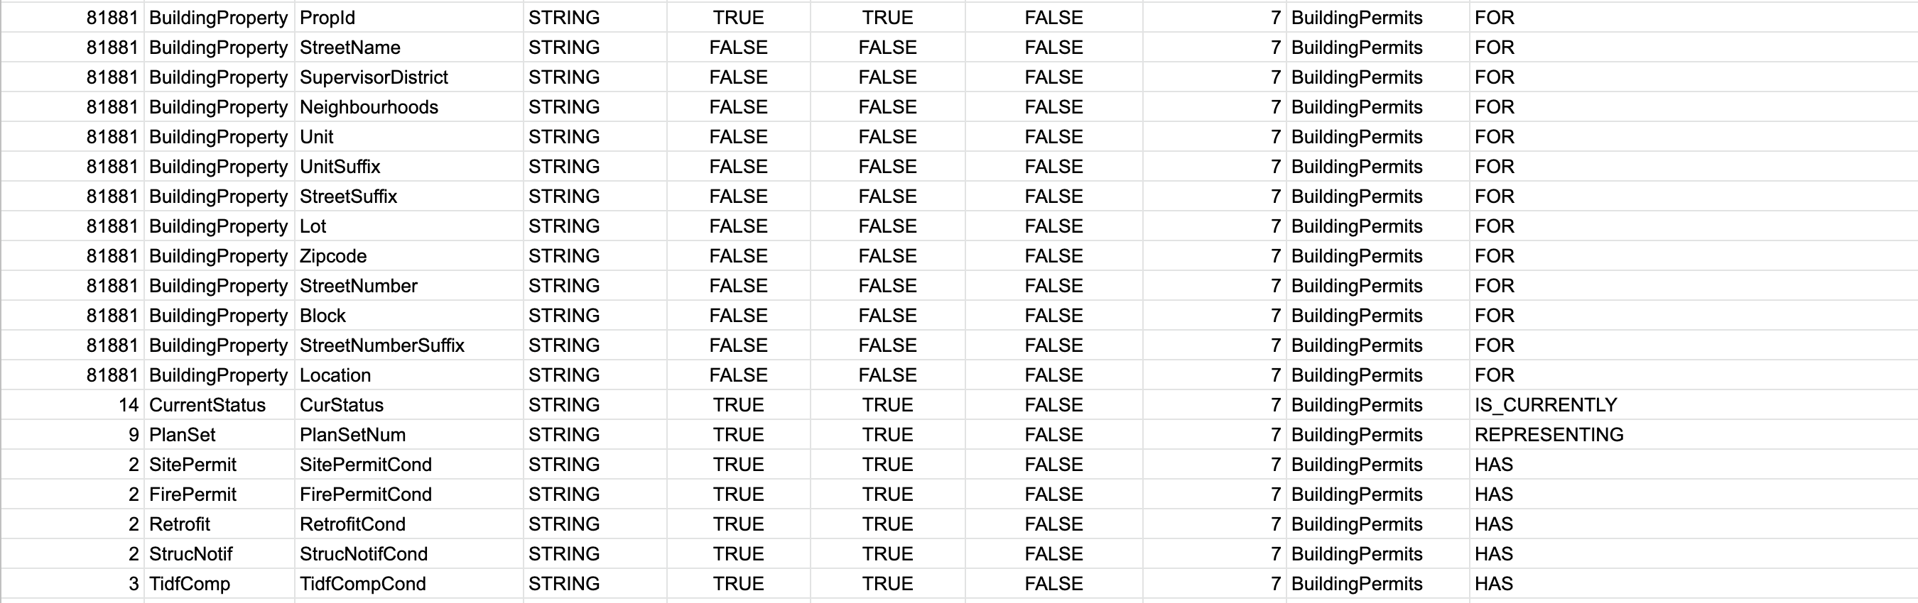
Technical Metadata

Slide 24
6. DATA VALIDATION

Slide 25
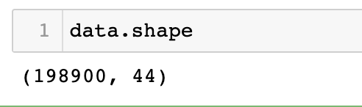
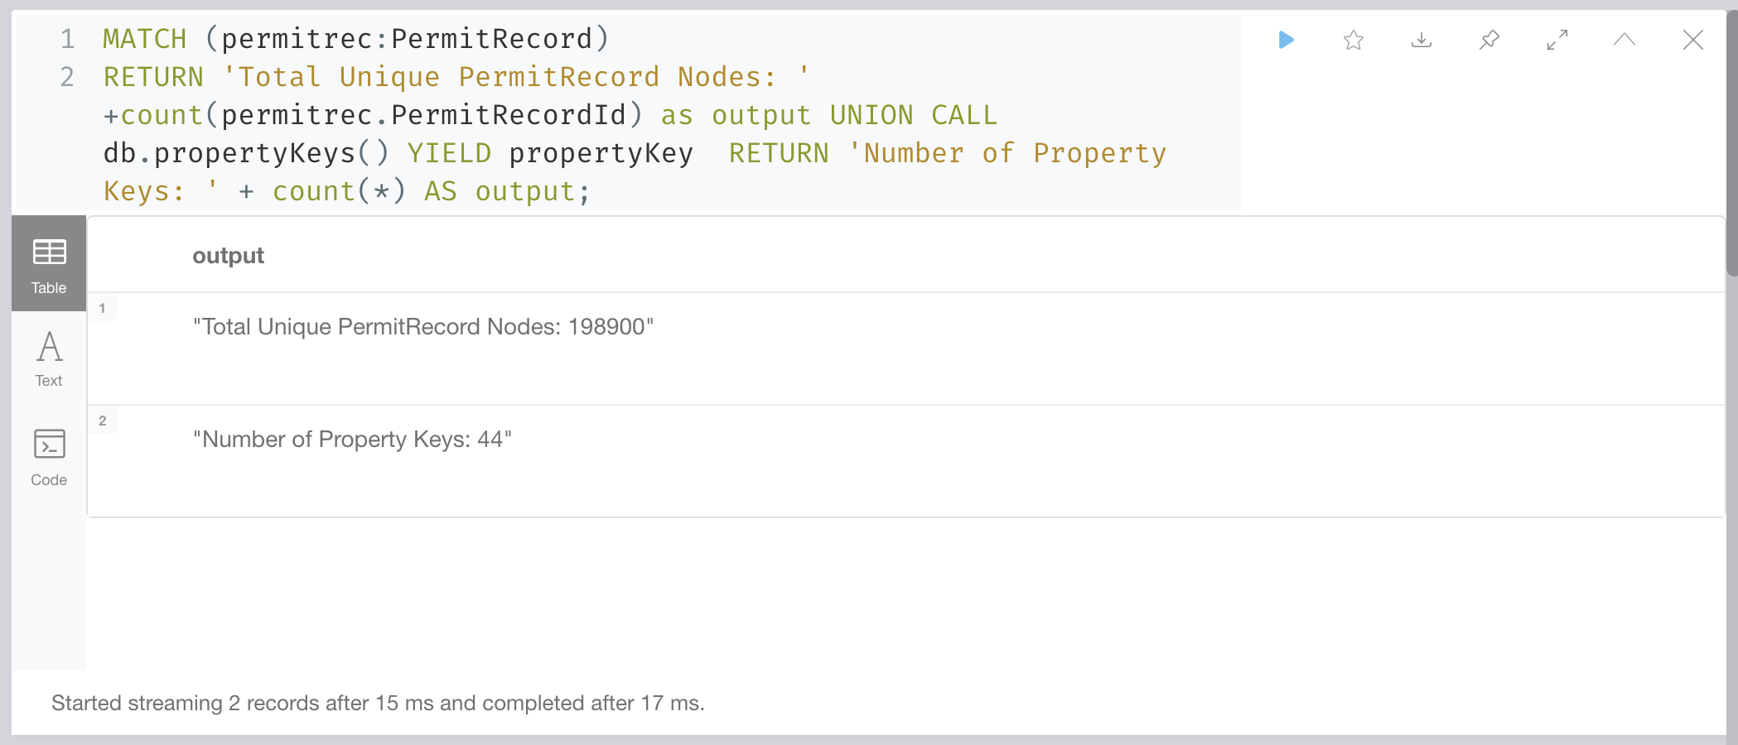
Total Counts
Before Loading (in Python):
After Loading (in Neo4j):

Slide 26
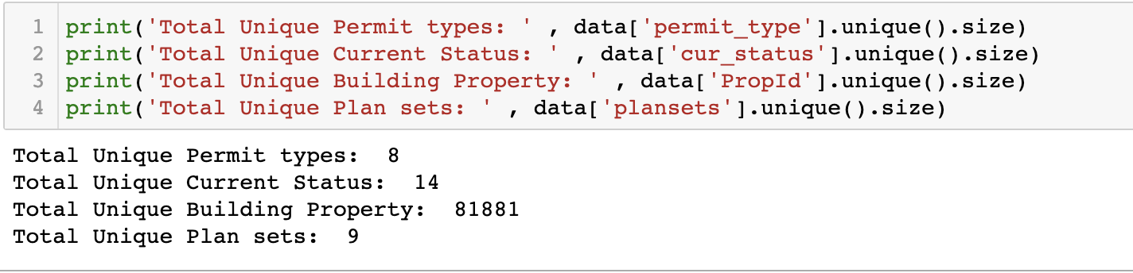
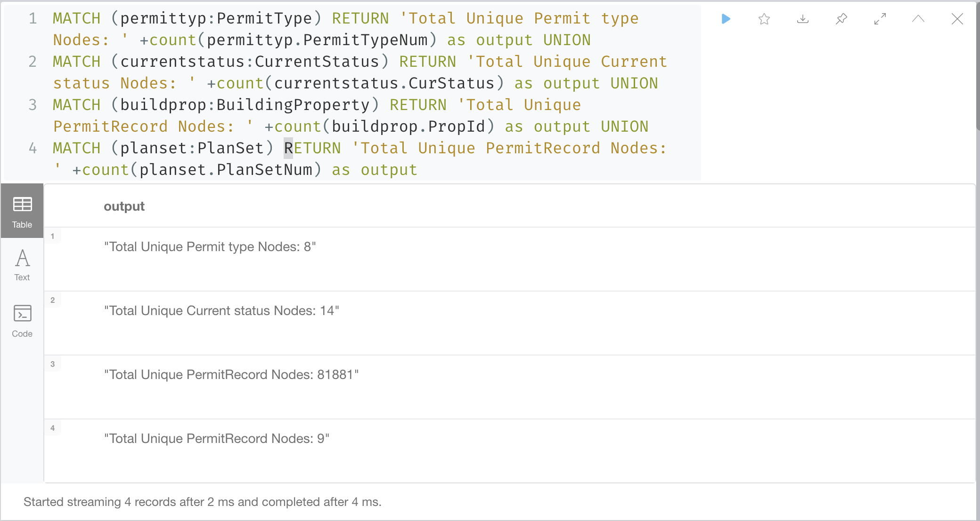
Total Node Counts
Before Loading (in Python):
After Loading (in Neo4j):

Slide 27
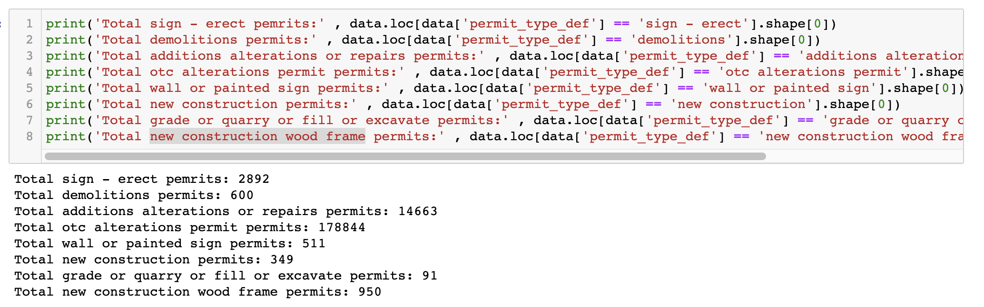
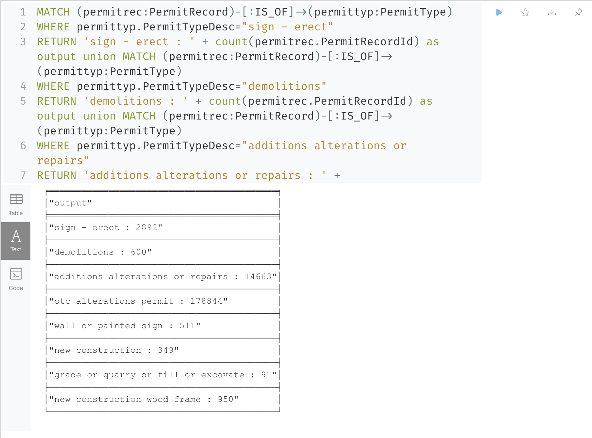
Number of permit records for a specific permit type
Before Loading (in Python):
After Loading (in Neo4j):

Slide 28
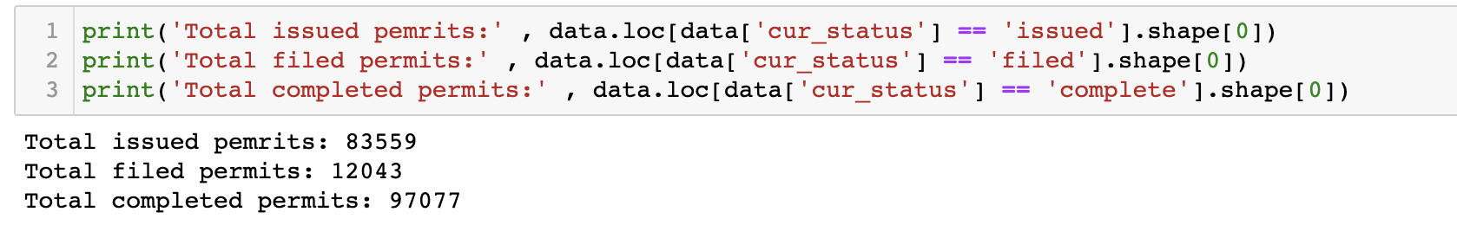
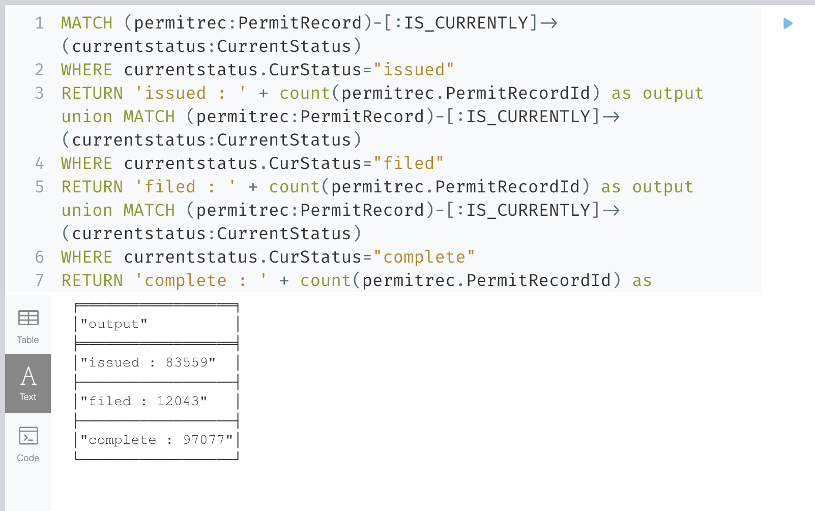
Number of permit records for a specific status
Before Loading (in Python):
After Loading (in Neo4j):

Slide 29
7. DATA VISUALIZATION

Slide 30
Who?
Why?
To get a clear idea of what the information means by giving it visual context
To show information about different trends in building permits data
Audience:
Building constructors (contractors/owners)
General Public
Media (TV, News, Radio)
Government
How?

Slide 31
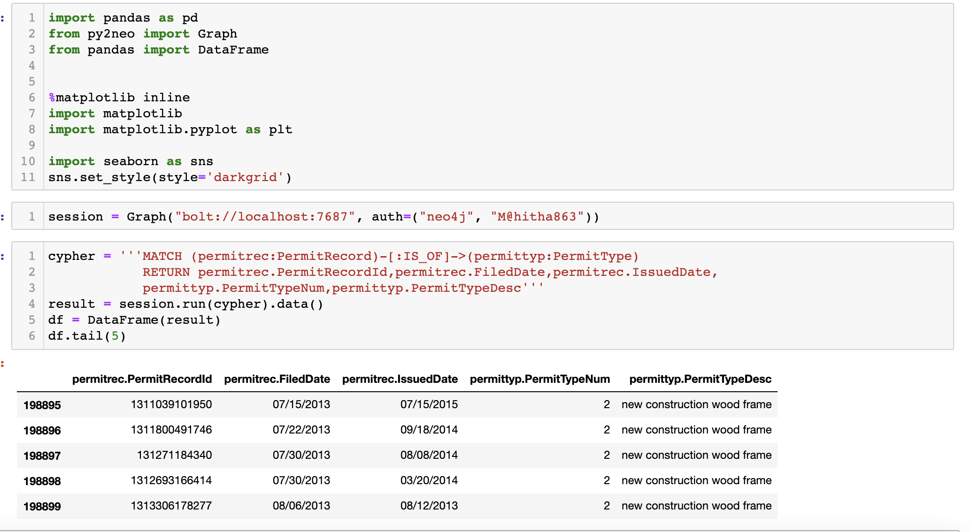
Connect to neo4j for data

Slide 32
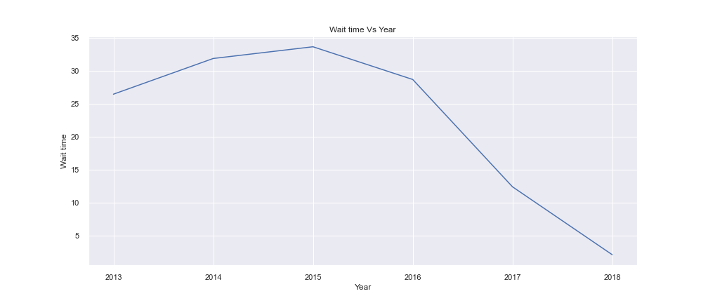
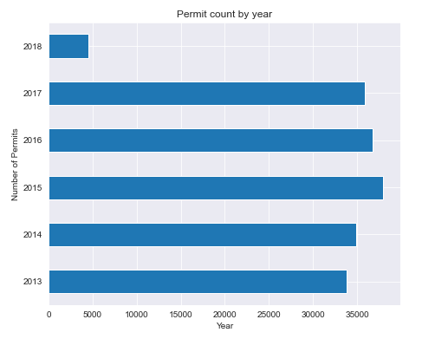
Permits filed : Year-wise Analysis
Analysis:
Wait time reduced considerably
Wait time is number of days between filed date and issued date
Permit counts are considerably constant every year

Slide 33
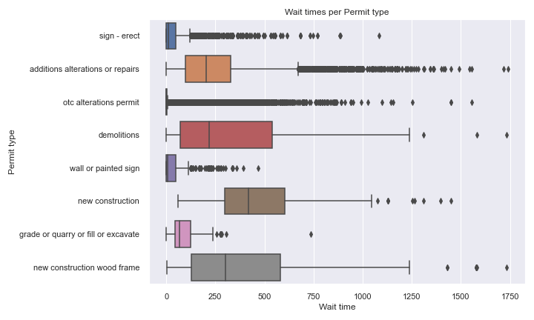
Wait time analysis for permit type
Analysis
New construction takes longer wait times
Wall or painter sign permits gets approvals fast

Slide 34
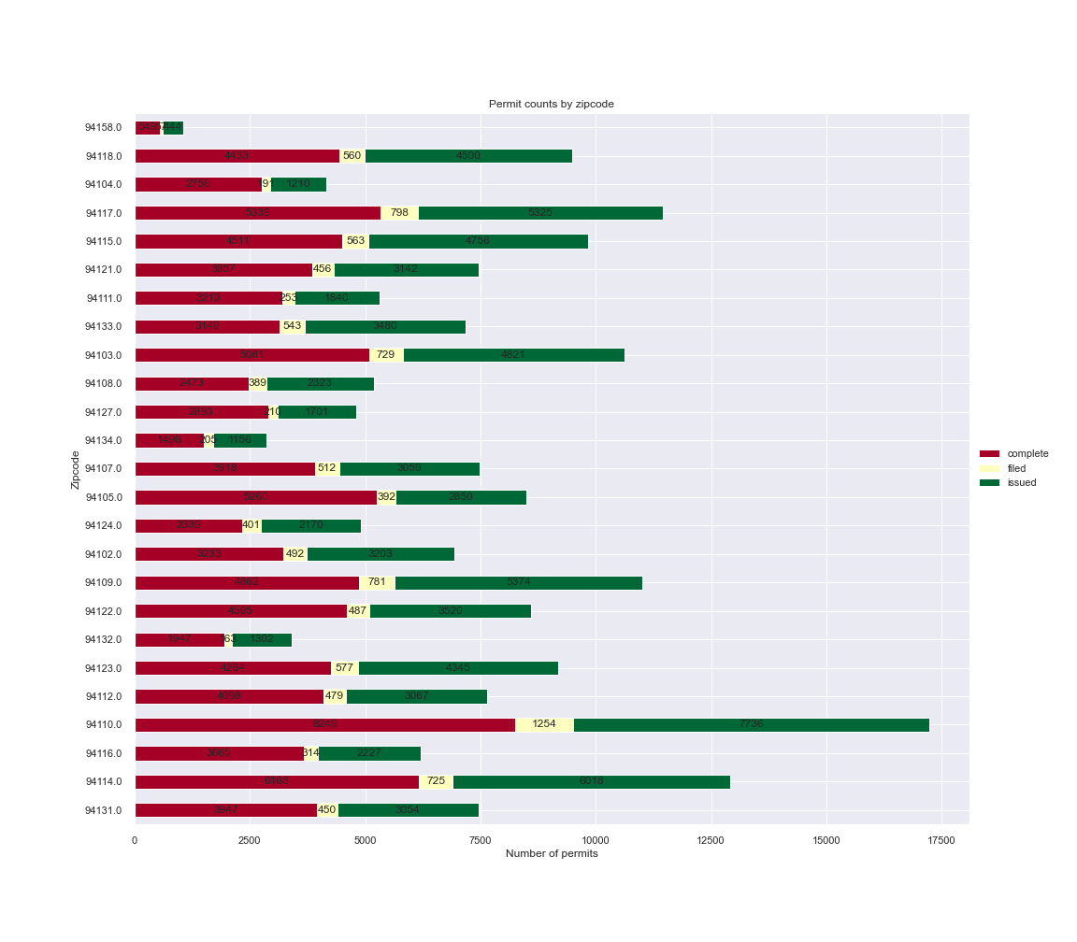
Permits filed - Area wise analysis
Analysis
Total permits from an area has been visualized
Area with more constructions and area with less constructions obtained
Also, the status of permits has been analyzed

Slide 35
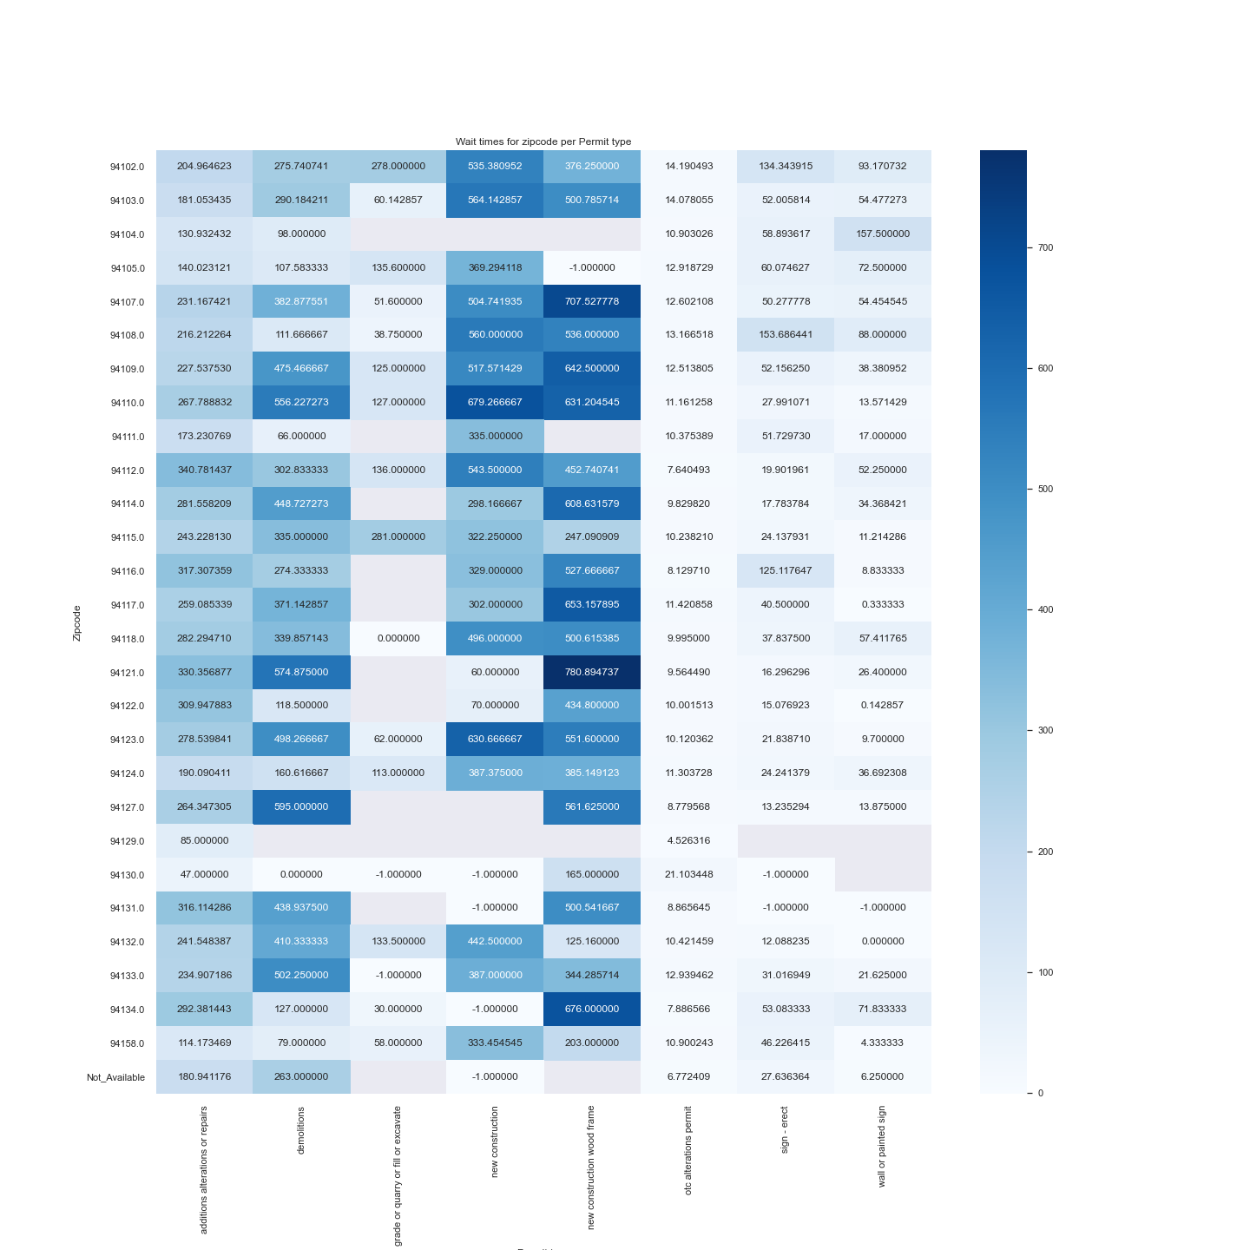
Area wise wait time analysis:
Analysis
Average time taken for permits to get issued per area has been visualized
Area that takes permits to issue faster and slower is shown

Slide 36
8. Velero Screenshots

Slide 37
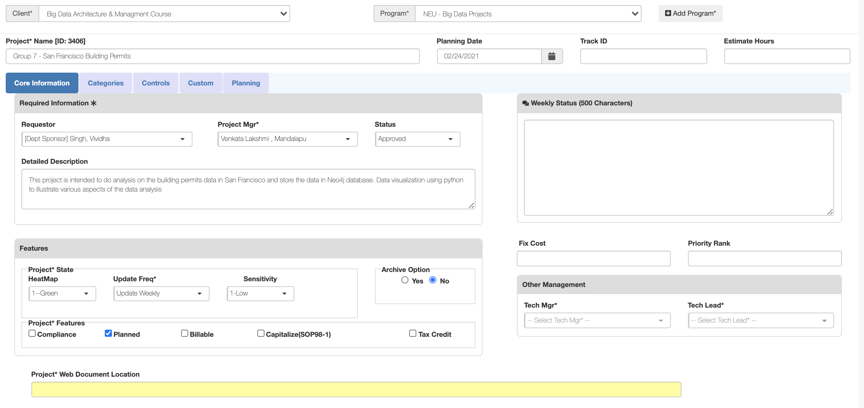
Project – Long Form

Slide 38
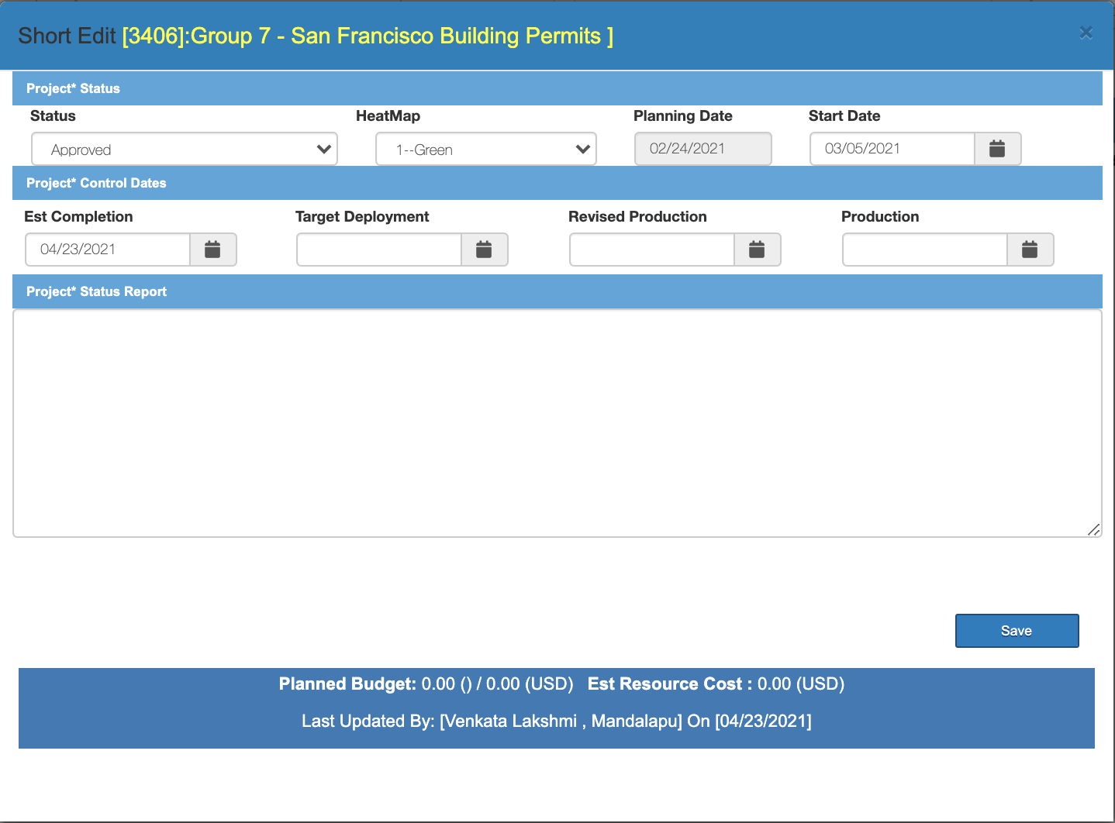
Project – Short Form

Slide 39
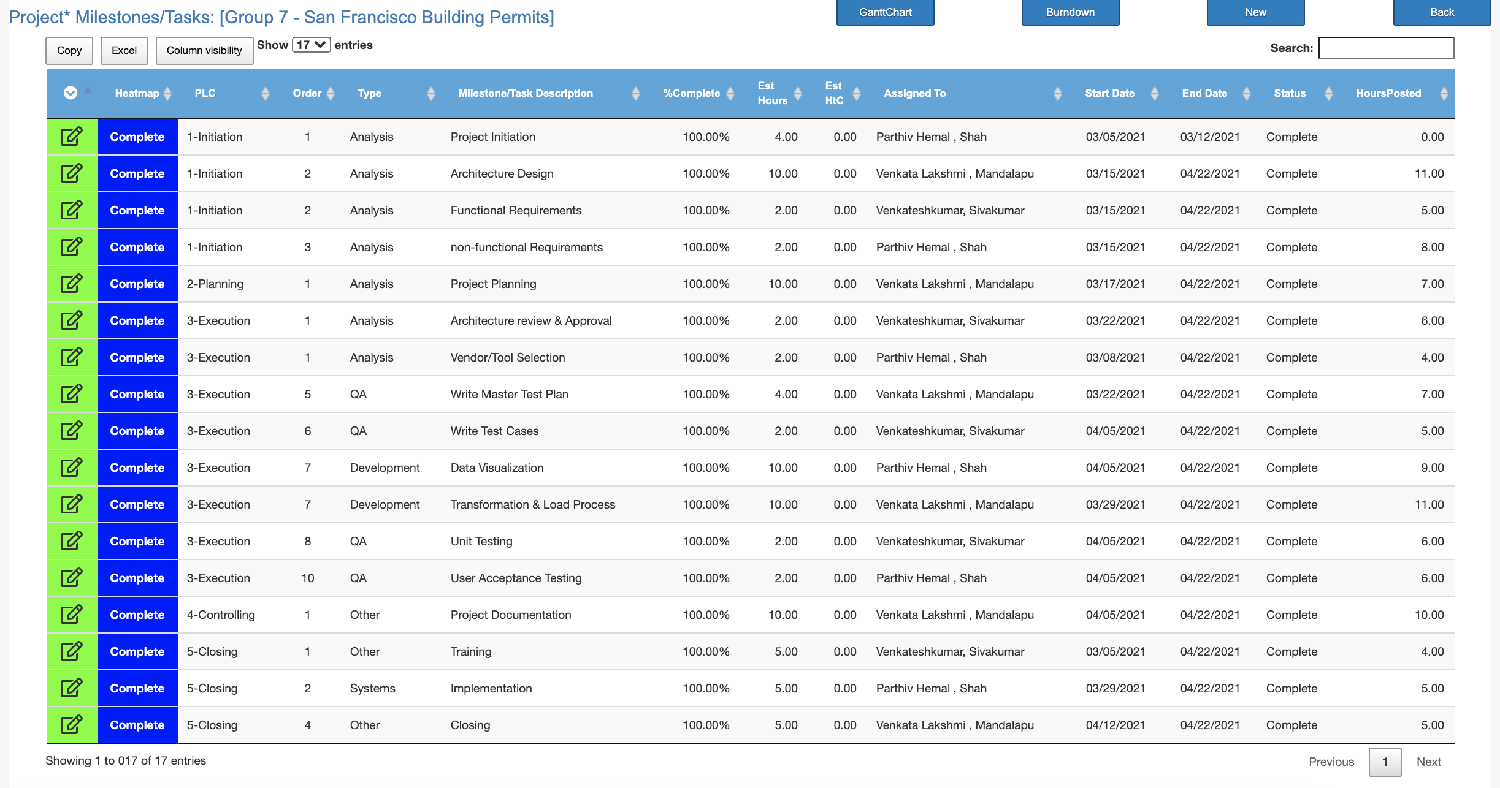
Project Plan

Slide 40
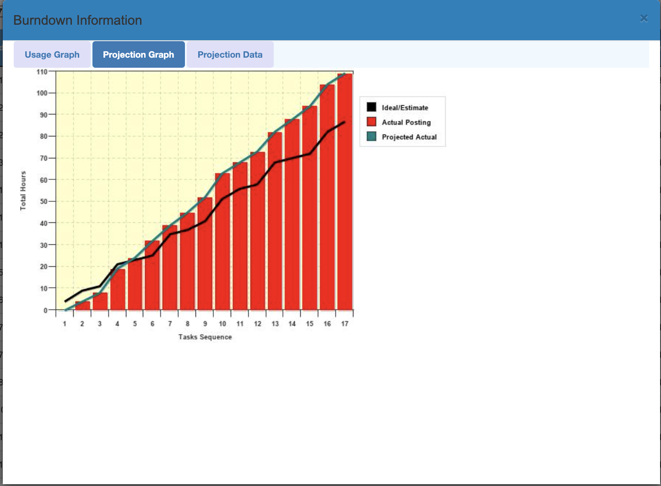
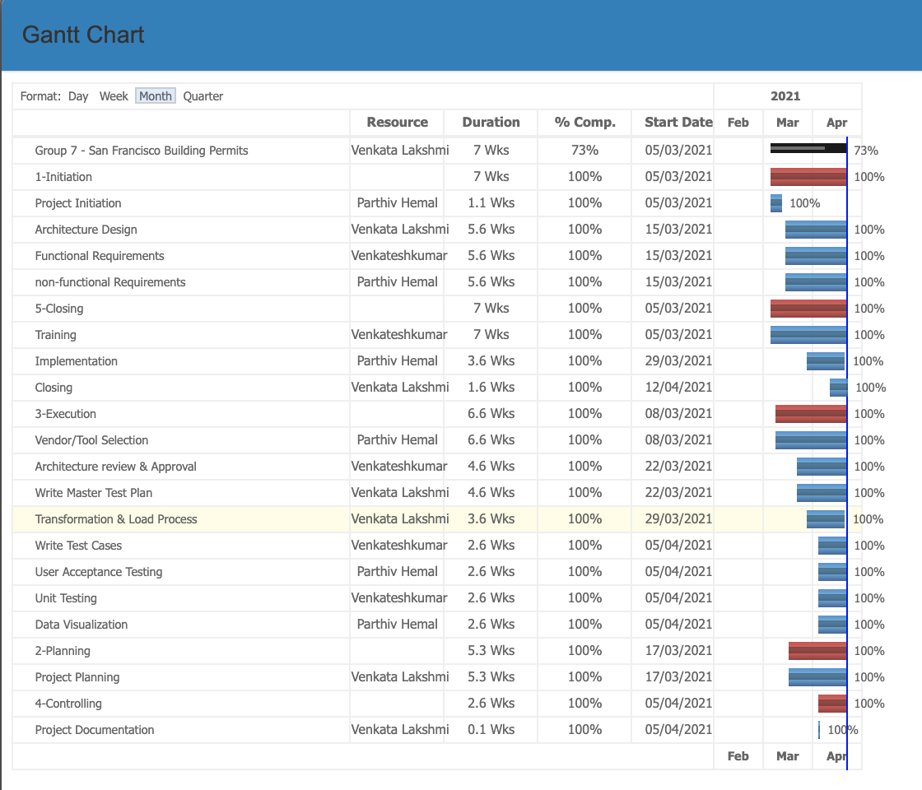
Project plan – Burndown/Gantt chart

Slide 41
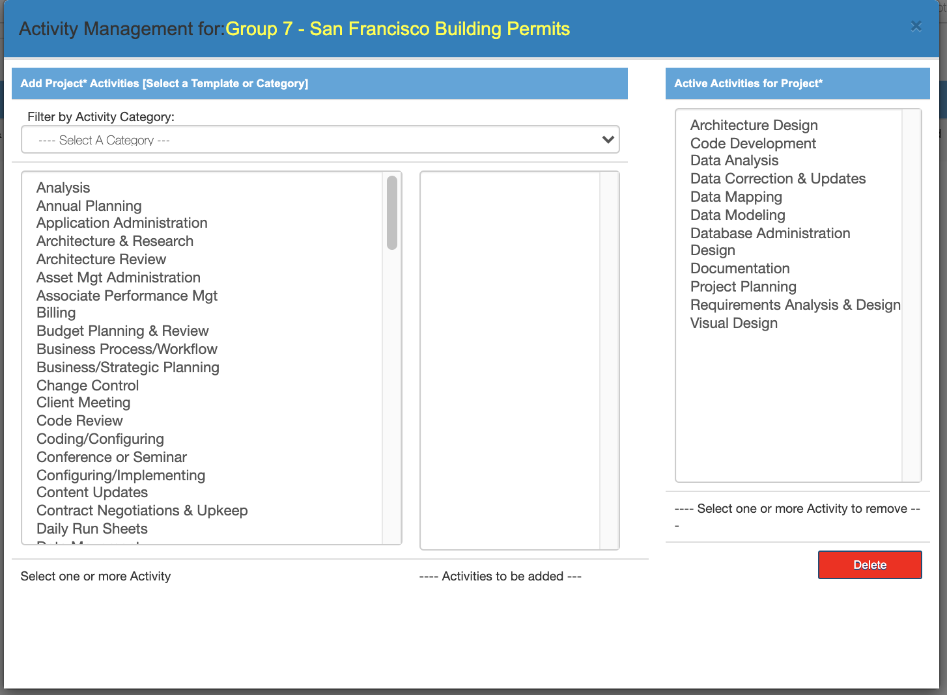
Project Activities

Slide 42
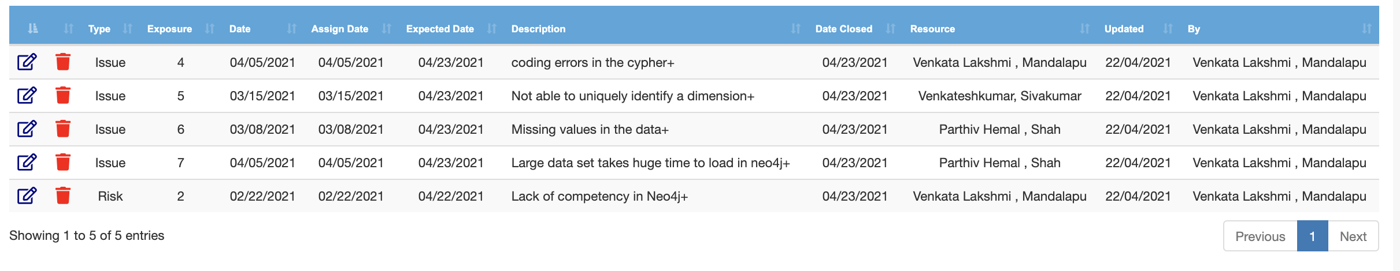
Risks/Issues

Slide 43
Thank you

